Slide 1

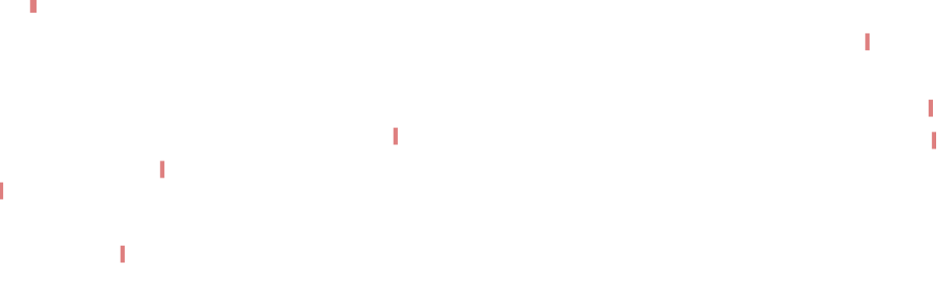
Auto-Associative Memory Network
x₁
y₁
Input pattern:
Output pattern:
x_{i}
y_{j}
Weight Matrix
Activation Function: Sign Function
Output Patterns: Bipolar/Binary
x_{n}
y_{n}
Such Networks are similar to Auto Encoders but dimensionality reduction is not the main purpose. Here, retrieving an original pattern from its disturbed or deformed form is the main goal.

Slide 2
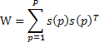
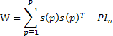
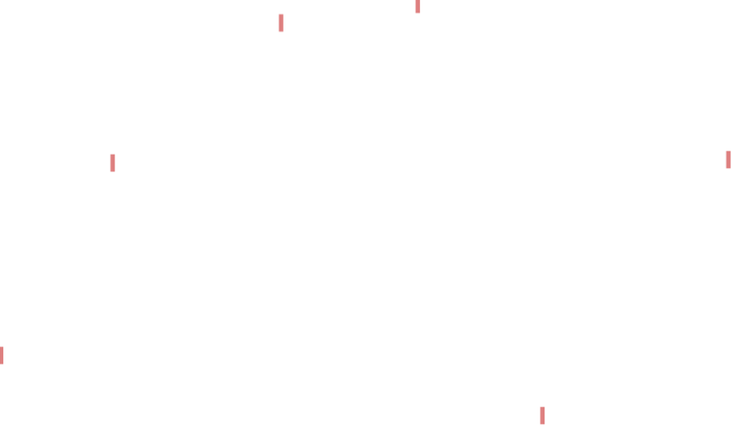
Modified Hebbian learning rule for Auto-associative Networks
Hebbian learning rule
Such weigh matrix (p.s.d (positive semi definite) and symmetric) causes that a self-associative network can make memory for “p “ orthogonal binary or bipolar patterns:
If “P” is increased then it can be shown that for bipolar patterns the weigh matrix becomes nearer to an Identify matrix. Hence, the capability of the network in associating the disturbed or deformed memorized patterns to their original forms is reduced. The domain of attraction about a certain pattern will be recued.
The modified Hebbian learning rule
It can be shown that the modified Heb learning method can still associate the disturbed or deformed orthogonal patterns to their original ones.

Slide 3
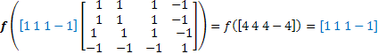
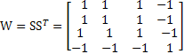
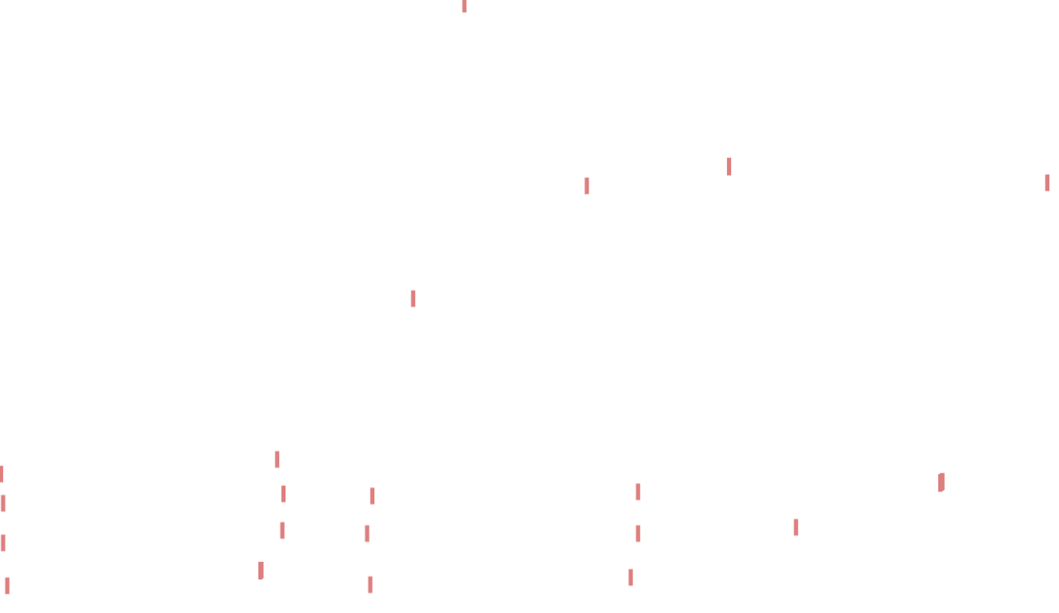
Example1: Store the bipolar pattern s^{T}=[1 1 1 -1] Activation function is bipolar “sign” function.
Input with one mistake components
Input with two missing components
Input with two mistake components
ok
ok
ok
Not Ok
ok
ok
ok
ok

Slide 4
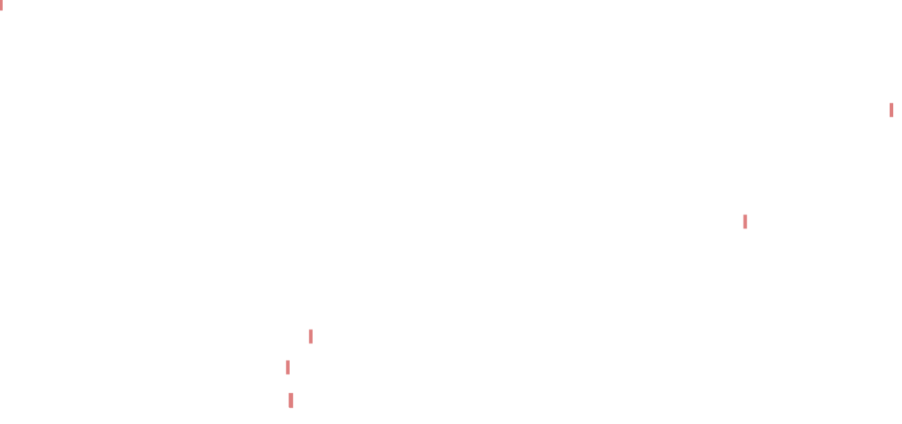
Recurrent Auto-Associative NET
W_{n*n}
x₁
y₁
OR
y₁
y_{i}
x_{i}
W_{n*n}
y_{i}
y_{n}
x_{n}
y_{n}
x₁
x_{i}
x_{n}
f(): Activation function
The iterations
x:=disturbed or deformed s(p)
y₁^{T}=f(x^{T}W)
y₂^{T}=f(y₁^{T}W)
y₃^{T}=f(y₂^{T}W)
.....
up to stop threshold
X → y₁ → y₂→ y₃ → …. → y_{final}
y_{j}^{=[y}_{1j}^{,..,y}_{ij}^{,..,y}_{nj}^{] T}

Slide 5
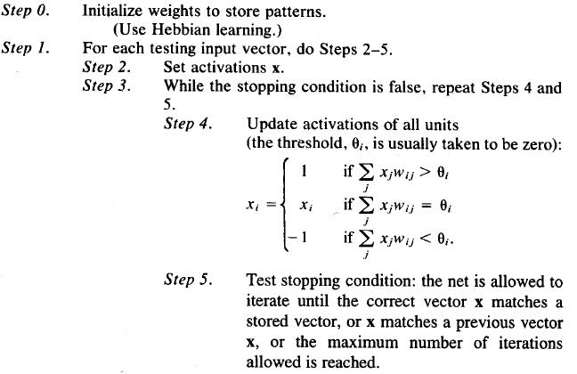
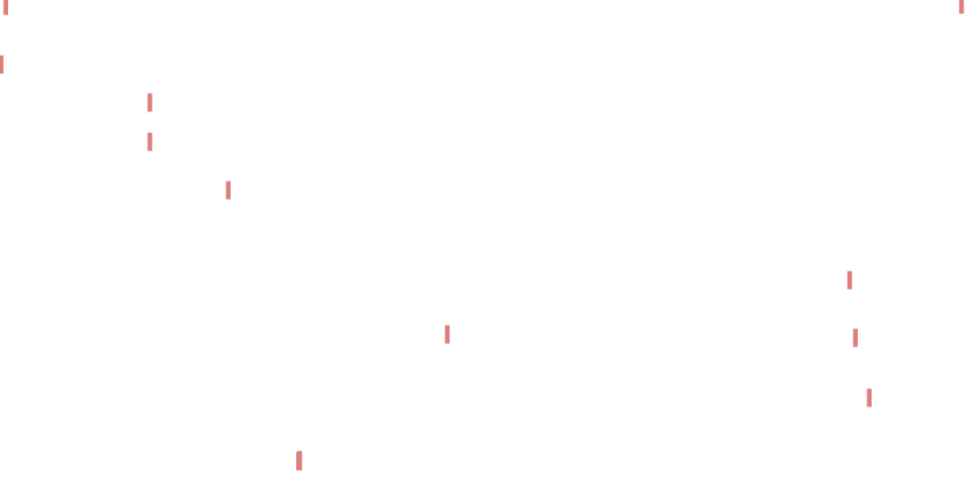
(Recurrent) Auto-Associative with threshold Function Algorithm:
* Here, Hebbian Learning is the same modified version.

Slide 6
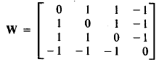
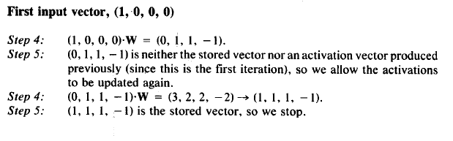
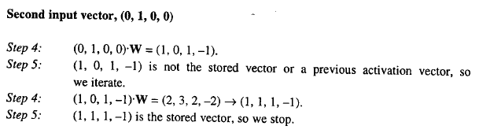
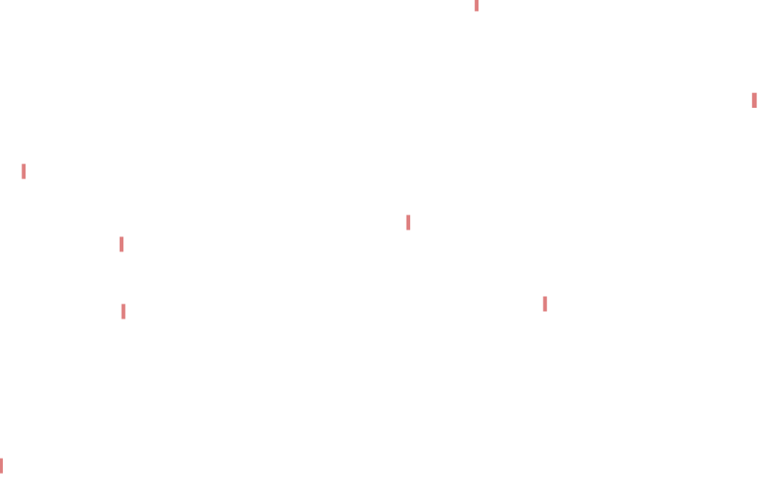
Example 1: store the vector (1,1,1,-1)
The Weight Matrix by Modified Hebbian
Learning Method
Three missing components
OK
Three missing components
OK

